Slide 1

Online Chat Aplication
Mahmudul Islam
UG02-47-18-004
Course Code – 0318
Course Name - Software Engineering
Department of Computer Science and Engineering
State University of Bangladesh

Slide 2
Overview
Introduction
Development Tools
Modules
Features
Conclution

Slide 3
Introduction
This project is an example of chat application which is basically based on public chatting (message is broadcast to all connected users)

Slide 4
Development Tools
Language
Front-end : HTML, CSS
Back-end : PHP and JavaScript
Database : MySQL
Tools
XAMPP
VS Code

Slide 5
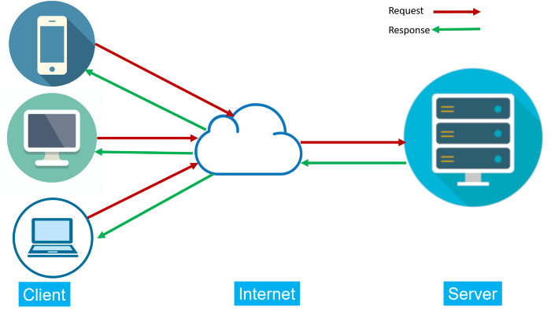

Slide 6


Slide 7
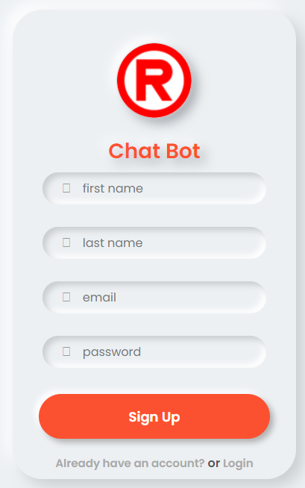

Slide 8
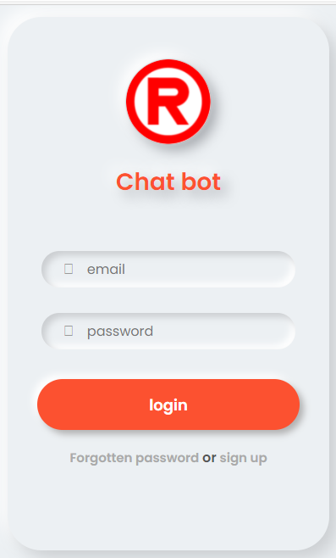

Slide 9
Features:
Sign in/Sign up
Profile Picture
View active users
Logout
Chat history

Slide 10
Future Scope
File Transfer
Video Chat
Voice Call
Client-Server

Slide 11
Conclution
There is always a room for improvements in any software package, however good and efficient it may be done. But the most important thing should be flexible to accept further modification Right now we are just dealing with text communication

Slide 12


